Slide 1
Introduction to Neural Networks
Computing Science
University of Alberta
Nilanjan Ray

Slide 2
Agenda
What is a Neural Net?
Neural net as a computational graph
Approximating “XOR” function with neural net
Universal function approximation by a neural net
MNIST digit classification using a neural network
Note: I am purposefully leaving out backpropagation from CMPUT 206 materials

Slide 3






Feed forward neural network
f is a non-linear function
g can also be non-linear
$$h_{1}=f(w_{11}x_{1}+w_{12}x_{2}+b_{1})$$
$$x_{1}$$
$$h_{2}=f(w_{21}x_{1}+w_{22}x_{2}+b_{2})$$
$$y=g(w_{1}h_{1}+w_{2}h_{2}+w_{3}h_{3}+b)$$
$$x_{2}$$
$$h_{3}=f(w_{31}x_{1}+w_{32}x_{2}+b_{3})$$
Input nodes
Output node
Hidden nodes

Slide 4
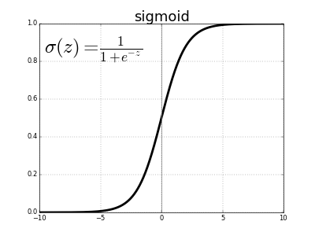
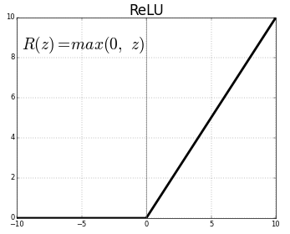
Feed forward net: non-linear functions
Non-linear functions at hidden nodes are known as “activation function”
Sigmoid, ReLU, ELU, ….
Why activation functions are non-linear?

Slide 5
Feedforward net in general: Directed acyclic graph
Input nodes
Hidden nodes
Output nodes

Slide 6
What’s the big deal about neural net?
Mathematically very rich: it can approximate any function
It is biologically inspired: (loosely) resembles neuron connections
Computationally:
Simple: matrix-vector multiplication and point-wise non-linear function
Highly paralleizable: cuBLAS, GEMM, Batched GEMM!
Excellent empirical results on “generalization capability” over variety of applications!

Slide 7




Approximating XOR
XOR function
1 | 0 | 1
0 | 0 | 0
0 | 1 | 1
1 | 1 | 0
XOR$\left(1,0\right)=1$
XOR$\left(0,0\right)=0$
XOR$\left(0,1\right)=1$
XOR$\left(1,1\right)=0$
We will design a neural net that will behave (approximately) like the above function XOR

Slide 8

Neural network to approximate XOR
Input (4x2 matrix)
(4x8 matrix)
(4x8 matrix)
(4x8 matrix)
(4x1 vector)
(4x1 vector)
Output (4x1 vector)
X
Z₁ = XW₁
Z₂ = Z₁+b₁
Z₃ = σ(Z₂)
Z₄ = Z₃W₂
Z₅ = Z₄+b₂
*
+
σ
*
+
σ
Y^{p} = σ(Z₅)
Loss
W₁
b₁
W₂
b₂
Parameter (2x8 matrix)
Parameter (1x8 vector)
Parameter (8x1 vector)
Parameter (scalar)
Y
X
Y
Ideal output (4x1 vector)
$$σ\left(a\right)=\frac{1}{1+exp⁡(−a)}$$
This network is
trying to learn
XOR function
1 | 0 | 1
0 | 0 | 0
0 | 1 | 1
1 | 1 | 0
Sigmoid function;
applied pointwise
to a vector or matrix input
Notebook: Learn_XOR.ipnyb

Slide 9
Universal function approximation
A neural network with a single hidden layer can approximate “any” function!
Wikipedia has a clear statement: https://en.wikipedia.org/wiki/Universal_approximation_theorem
A non-technical explanation of universality theorem:
http://neuralnetworksanddeeplearning.com/chap4.html
Why do we then even need multiple layers and why even deep nets?

Slide 10
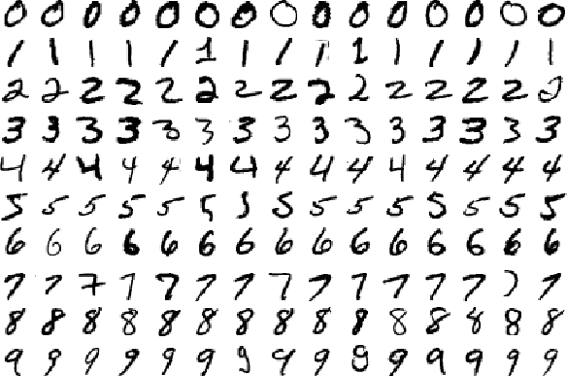
MNIST Digit Classification
Classify images into digits
Each image is 28x28
10 labels
55,000 training images
5,000 validation images
10,000 test images.

Slide 11

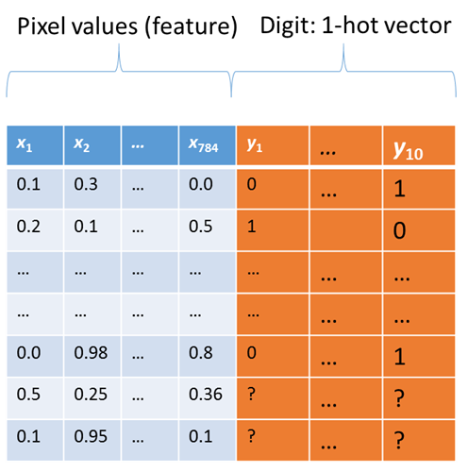
MNIST classification problem
Small 28 pixels-by-28 pixels images of hand written digits
The visual recognition problem definition:
to recognize the digit from an image

Slide 12
NN Architecture for MNIST Classification
X: input
Z1=f(X*W1+b1)
Z1
Z2=f(Z1*W2+b2)
Z2
Z3=Z2*W3+b3
Z3
Yp=Softmax(Z3)
Yp
W1, b1: parameters
W2, b2: parameters
W3, b3: parameters
Activation function, f is ReLU in our implementation
Notebook: MNIST_NN.ipynb

